Slide 1

TVM & Notes Receivable - Video

Slide 2
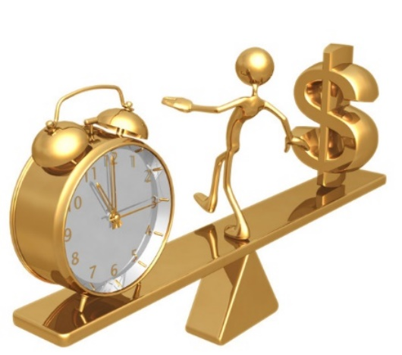
Time value of money
Simply put…
A dollar available today is worth more than a dollar in the future.
Notes:
If you asked me if I wanted 50,000 today or 100,000 in a year, I would probably pick 100,000
If you asked me if I wanted 50,000 today or 50,000 in a year, I would pick 50,000 today. The value of the $50,000 I have to wait for is lower today than the value of the $50,000 I get today. There are things I can do with the $50,000 over the course of the year. If I had the money now I could spend it or even better, I can earn interest; generate return in the stock market, or start a business to grow the money. In order to determine what a cash flow I expect in the future is worth today I need to calculate the cash flows present value.
What do I need to know to do that: INTEREST

Slide 3
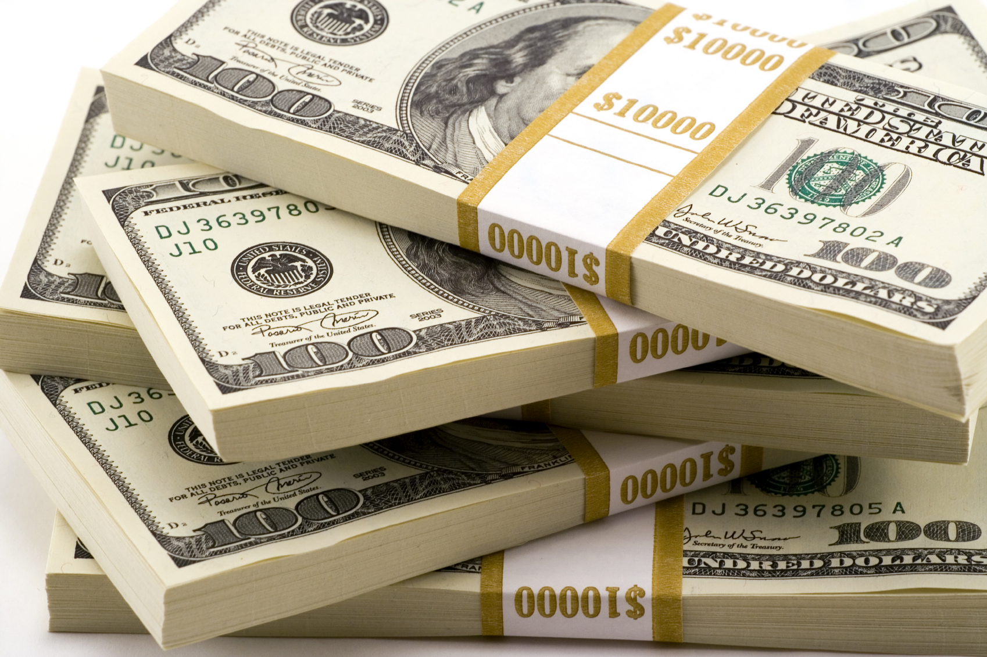
Time value of money
Today
10 years from now
Why is cash today preferred?
Invest
Uncertainty about the future
Risk
vs.
Notes:
If you asked me if I wanted 50,000 today or 100,000 in a year, I would probably pick 100,000
If you asked me if I wanted 50,000 today or 50,000 in a year, I would pick 50,000 today. The value of the $50,000 I have to wait for is lower today than the value of the $50,000 I get today. There are things I can do with the $50,000 over the course of the year. If I had the money now I could spend it or even better, I can earn interest; generate return in the stock market, or start a business to grow the money. In order to determine what a cash flow I expect in the future is worth today I need to calculate the cash flows present value.
What do I need to know to do that: INTEREST

Slide 4
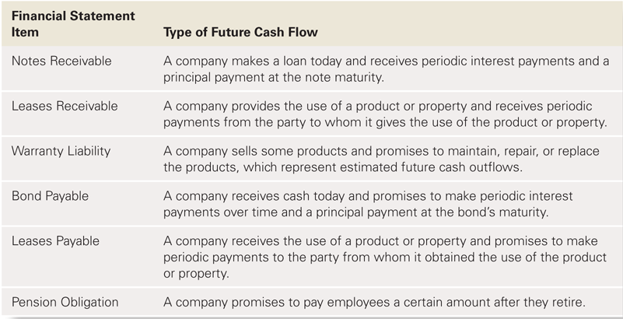
Why do we care?
Contractual cash flows sometimes occur far in the future.
© Pearson Education, Inc.

Slide 5
Review of Terminology
Interest
Compounding
Effective interest rate
Future Value
Present Value
Single Sum
Annuity

Slide 6
Interest
Interest is the price of money - excess cash received/paid over the principal.
Interest rates are generally stated on an annual basis.
Simple Interest
Interest on principal only. Interest = principal × interest rate × time Used for short-term only.
Compound Interest
Interest on principal and interest earned that has not been paid out/withdrawn. Compounded over any time period – convert rate by # of periods per year. Usually used for long-term items.
Notes:
Simple interest – what we have done so far, short term, multiply what you owe by the interest rate, convert for the # of months/years
Compound interest – you pay interest on interest that you haven’t paid yet.
-Compounds monthly but paid annually, calculate interest for month 1, add it to the balance. Month two interest is the rate * original balance + month 1 interest

Slide 7
Compounding
If the compounding period is <1 year:
Convert interest rate: Divide the annual interest rate by the number of compounding periods per year
12% compounded quarterly = 0.12 / 4 = 0.03
Convert # of periods: Multiply the number of years by the number of compounding periods per year
5 year loan compounded monthly = 5 × 12 = 60 periods

Slide 8
Effective interest rate
Example: Krei Inc. invests $1,000,000 for a year at a stated rate of 10%, compounded semiannually. What is the effective interest rate?
Interest in first 6 months: 1,000,000 × (10%/2) = 50,000
Interest in second 6 months : 1,050,000 × (10%/2) = 52,500
Effective interest rate = (50,000+52,500)/1,000,000 = 10.25%
Notes:
When interest is compounded more than once a year, effective interest rate is actual amount of interest earned in a year.
If compounded more than once a year, effective rate > stated rate

Slide 9
Single or Lump Sum
Single sum (lump sum): a single amount of money that either exists now or will exist in the future.
ACCUMULATING by i
Present value
DISCOUNTING by i
Future value
$$$
$$$
0
1
2
3
4
Notes:
Lump sum
I promise to pay $1,000 10 years from now, that is the future value
How much you pay me today for that is the present value
You loan me $1,000 today (present value)
How much I will repay in 10 years is the future value
Annuity – a series of payments
I pay $100 every year for 10 years
Present value – how much would you pay me today for that stream of payments
Future value – What is the value at the end of the 10 years
If you know 3 of the variables, you can always solve for the fourth.

Slide 10
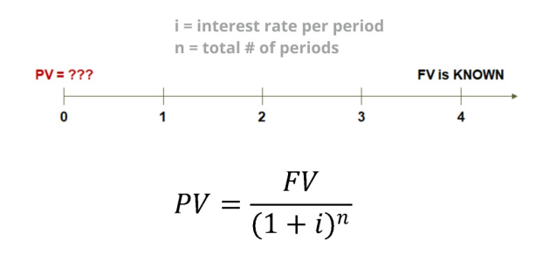
Future Value of a Single Sum
What is a future lump sum worth today?

Slide 11
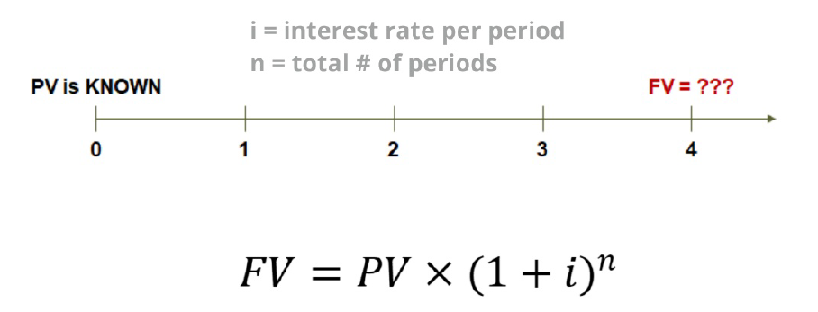
Future Value of a Single Sum
What is a lump sum today worth in the future?

Slide 12
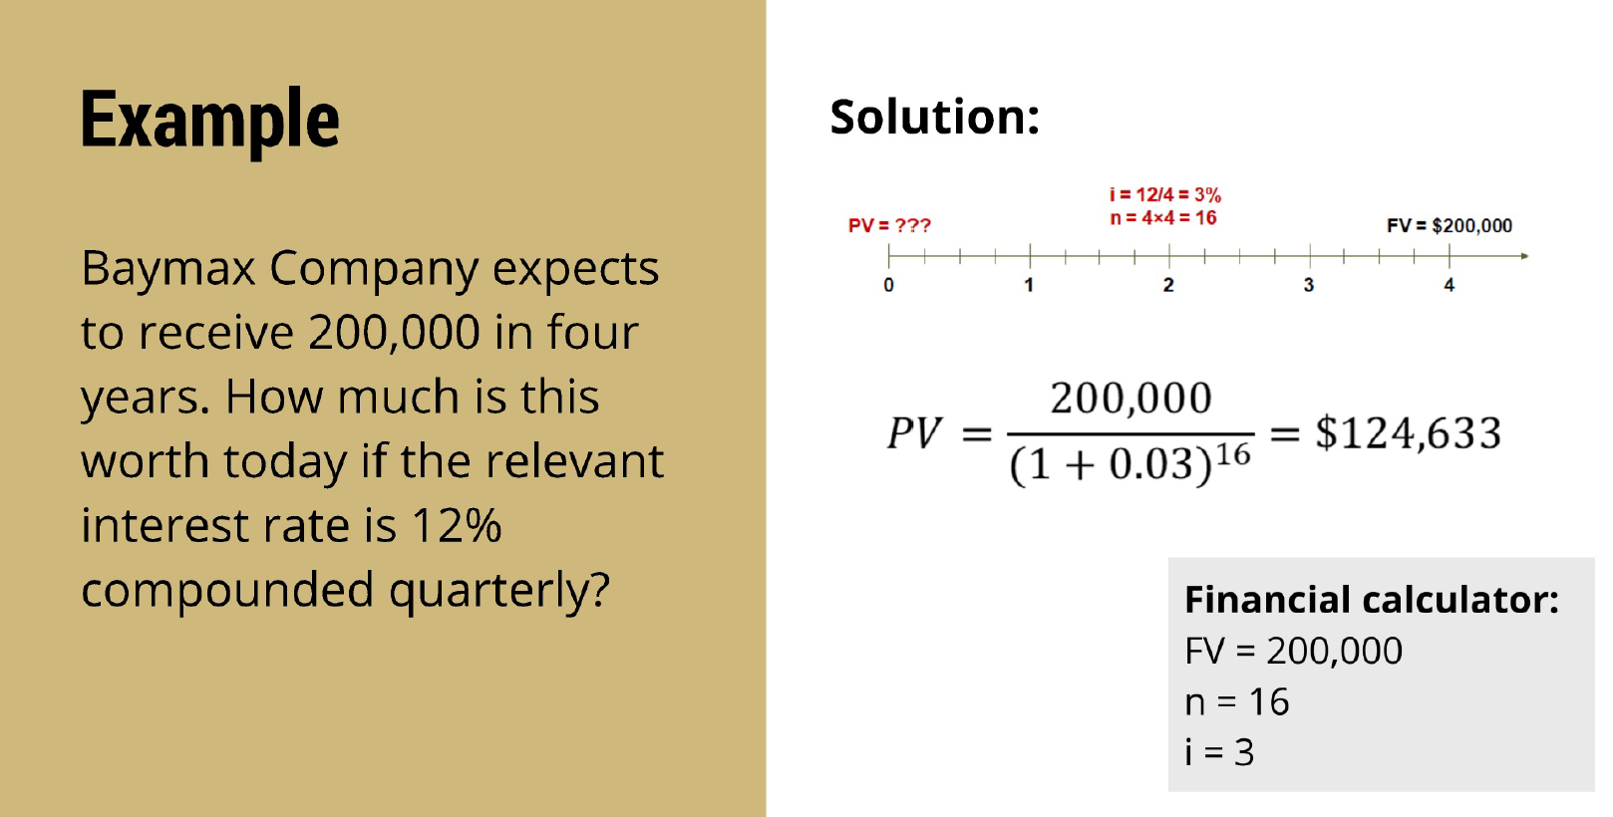

Slide 13
Annuity
Annuity: a series of equal periodic payments
With an ordinary annuity (or annuity), payments occur at the end of each period (ASSUME THIS WHEN I SAY “ANNUITY”)
With an annuity due, payments occur at the beginning of each period
ACCUMULATING
Present value
DISCOUNTING
Future value
$$$
$$$
PMT
PMT
PMT
PMT
0
1
2
3
4
PMT
PMT
PMT
PMT
Notes:
Lump sum
I promise to pay $1,000 10 years from now, that is the future value
How much you pay me today for that is the present value
You loan me $1,000 today (present value)
How much I will repay in 10 years is the future value
Annuity – a series of payments
I pay $100 every year for 10 years
Present value – how much would you pay me today for that stream of payments
Future value – What is the value at the end of the 10 years
If you know 3 of the variables, you can always solve for the fourth.

Slide 14
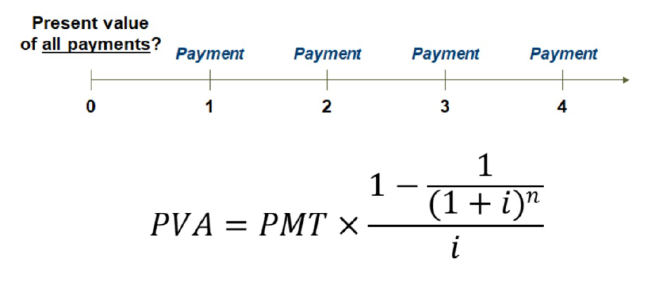
Present Value of an Annuity
What is a series of future payments worth today?

Slide 15
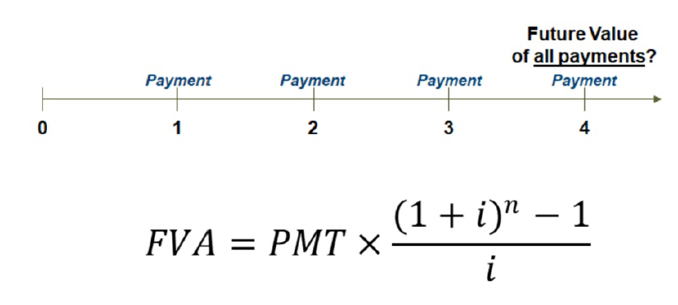
Future Value of an Annuity?
What is the future value of a series of payments?

Slide 16
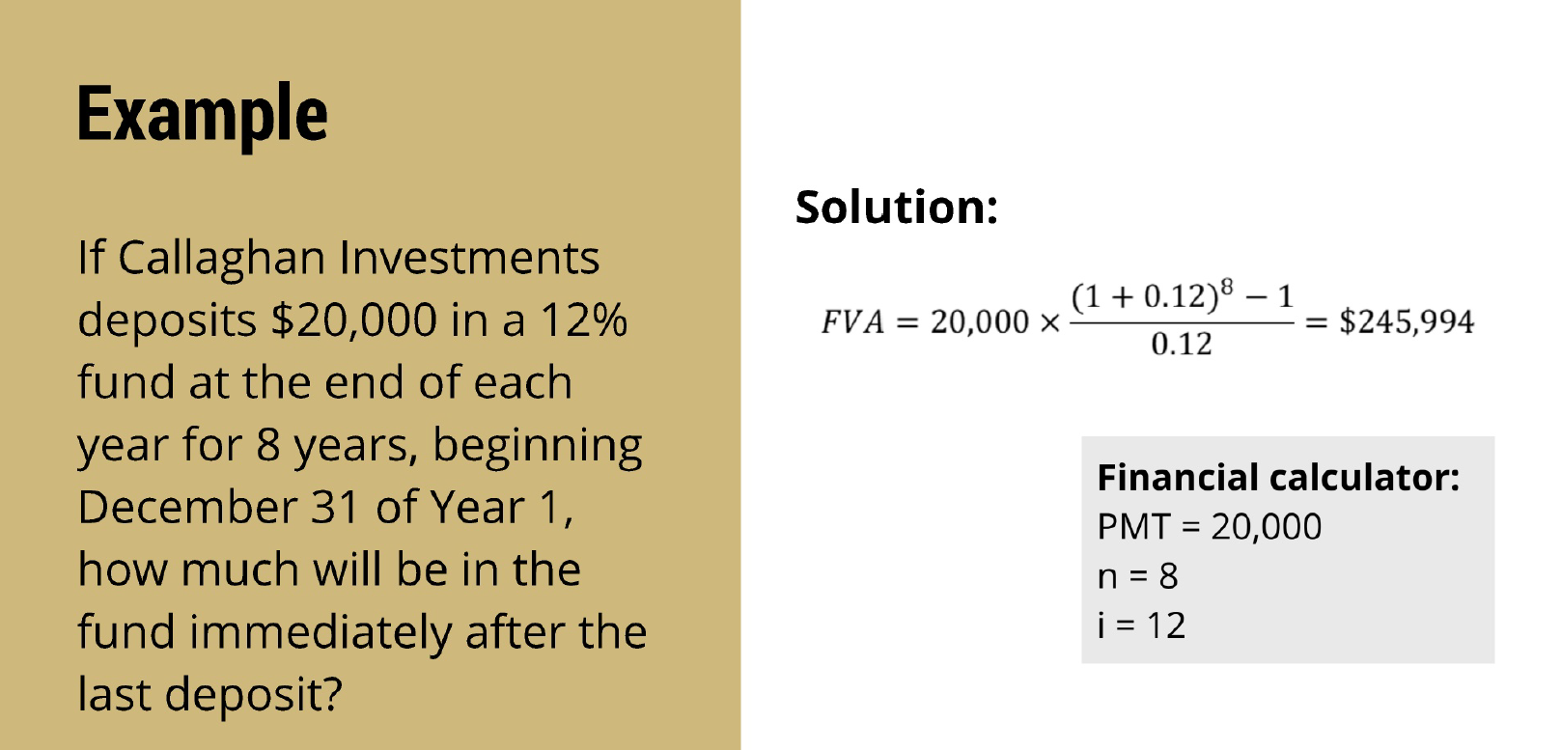

Slide 17
Closing Thoughts
Time value of money can be used to value certain accounts on the balance sheet.
Present value refers to today’s value of cash flows, and future values refers to value in the future.
Be comfortable with the lump sum and annuity – we often combine these!

Slide 18
TVM & Notes Receivable - Video

